Slide 1







Slide 2
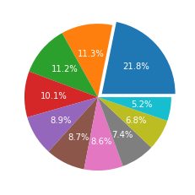
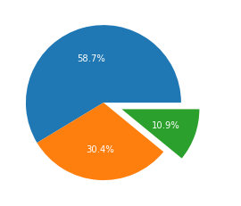
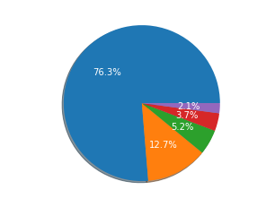
Country wise reviews
Rating Percentage
Sentiment Analysis
We have noticed that most of the reviews
were submitted by the customers of the UK.
We can see most number of customer has given 1 star rating which tells us that if a customer is un-happy with the service, then customer is most likely to give 1 star.
58.7% of the reviews submitted are positive,
30% of the reviews are negative and rest
10.9% are Neutral
Customers generally appreciated the cabin crew and staff, and found the general economy seats satisfactory. Many customers opted to travel in business class. The airline should focus on improving economy class service, seats, inflight entertainment, and reducing delays. In addition, the business class experience should be enhanced to offer better value for money. Improvements should also be made to the customer service process for refund requests.

